Slide 1

Lab 5: Forces and Vectors
St. Petersburg College

Slide 2
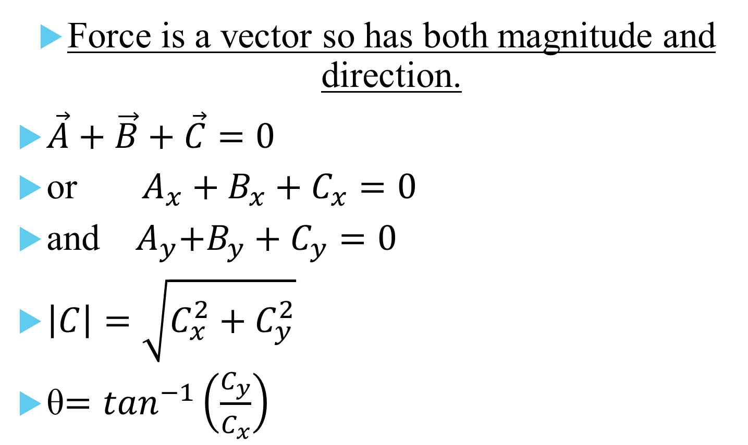
Theory
Force is a vector so has both magnitude and direction.
$\vec{A}+\vec{B}+\vec{C}=0$
or $A_{x}+B_{x}+C_{x}=0$
and ${ A}_{y}+B_{y}+C_{y}=0$
$\left|C\right|=\sqrt{C_{x}^{2}+C_{y}^{2}}$
θ$=\tan^{−1}\left(\frac{C_{y}}{C_{x}}\right)$

Slide 3
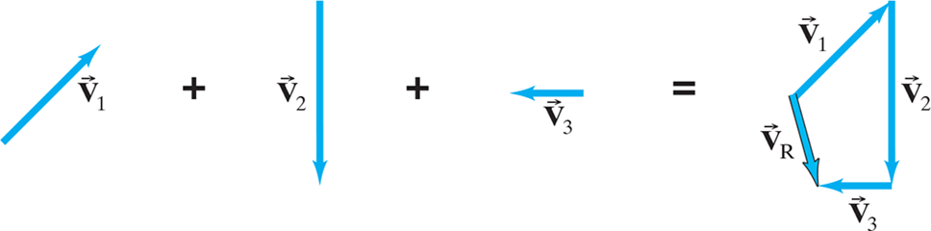
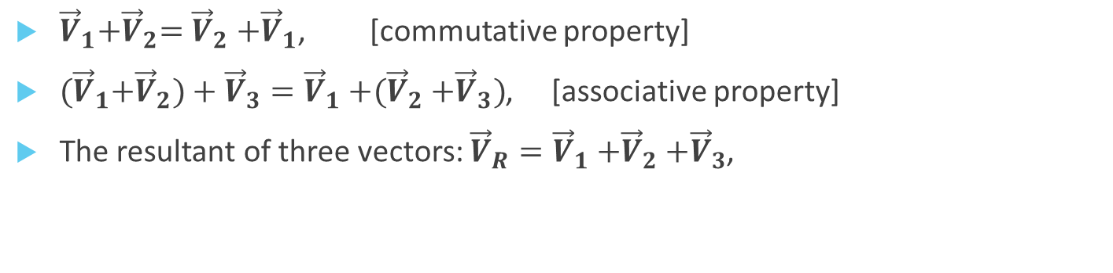
Theory, Cont.
${\vec{V}}_{1}{+\vec{V}}_{2}={\vec{V}}_{2}{+\vec{V}}_{1}$, [commutative property]
${(\vec{V}}_{1}{+\vec{V}}_{2})+{\vec{V}}_{3}={\vec{V}}_{1}{+(\vec{V}}_{2}+{\vec{V}}_{3})$, [associative property]
The resultant of three vectors: ${\vec{V}}_{R}={\vec{V}}_{1}{+\vec{V}}_{2}+{\vec{V}}_{3}$,

Slide 4
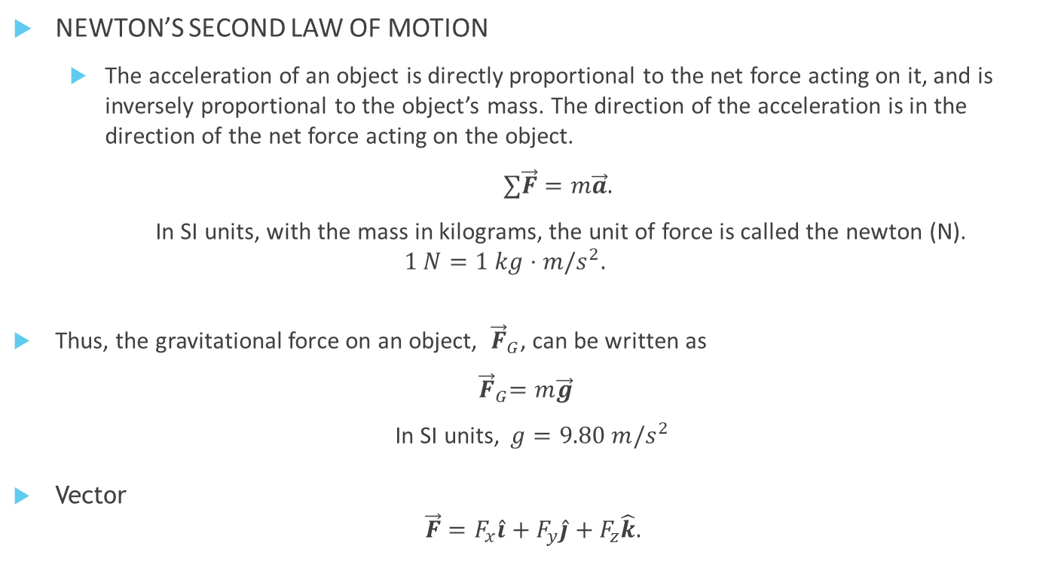
Theory, Cont.
NEWTON’S SECOND LAW OF MOTION
  The acceleration of an object is directly proportional to the net force acting on it, and is inversely proportional to the object’s mass. The direction of the acceleration is in the direction of the net force acting on the object.
  $∑\vec{F}=m\vec{a}.$
  In SI units, with the mass in kilograms, the unit of force is called the newton (N).
  $$1 N=1 kg⋅m/s^{2}.$$
Thus, the gravitational force on an object, ${ \vec{F}}_{G}$, can be written as
${ \vec{F}}_{G}=m\vec{g}$
In SI units,$g=9.80 m/s^{2}$
Vector
$$\vec{F}=F_{x}\hat{i}+F_{y}\hat{j}+F_{z}\hat{k}.$$

Slide 5

Introduction
Given three forces, $\vec{A}, \vec{B}$, and $\vec{C}$, acting on the center ring of the force table, the ring would accelerate by $F=ma$, unless $\vec{A}+\vec{B}+\vec{C}=0$. This means that the$x$and $y$ components must also sum to zero. In this lab, we will set up $\vec{A}$ and $\vec{B}$ and both measure and calculate the magnitude and direction of vector $\vec{C}$ as follows.

Slide 6
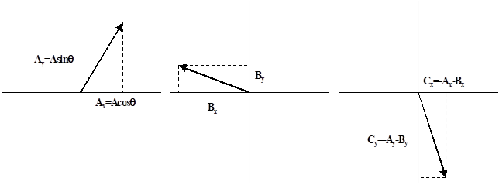
Vectors on Force Table

Slide 7
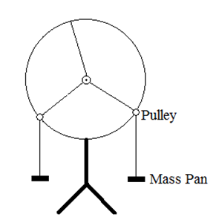
Objective
To visually see vector relationships by adding force vectors and comparing the experimental and calculated force to balance them.

Slide 8
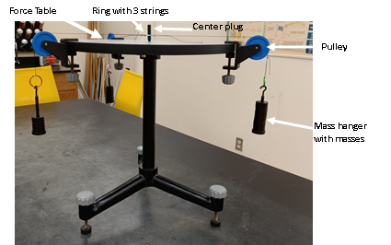
Apparatus
Force Table
Ring with 3 strings
Mass sets
Mass hangers
Pulleys
e-balance
Center nail

Slide 9
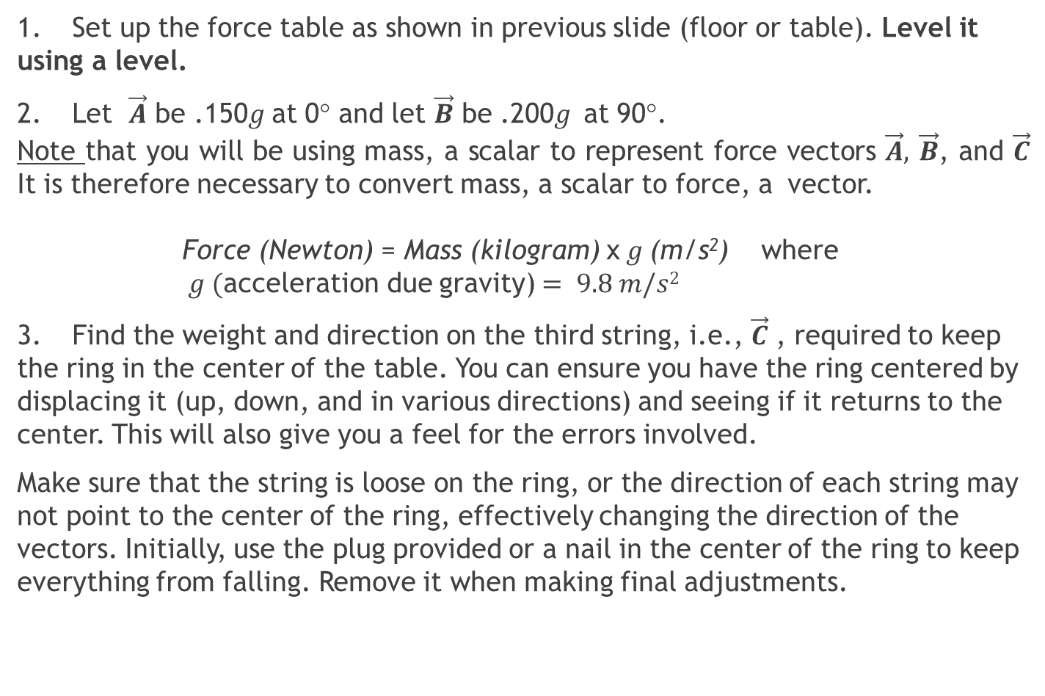
Procedure 1: Balancing Forces
1. Set up the force table as shown in previous slide (floor or table). Level it using a level.
2. Let $\vec{A}$ be .150$g$at 0° and let $\vec{B}$ be .200$g$at 90°.
Note that you will be using mass, a scalar to represent force vectors $\vec{A},$ $\vec{B}$, and $\vec{C}$ It is therefore necessary to convert mass, a scalar to force, a vector.
Force (Newton) = Mass (kilogram) x$g$(m/s²) where $g ($acceleration due gravity) $= 9.8 m/s2$
3. Find the weight and direction on the third string, i.e., $\vec{C}$ , required to keep the ring in the center of the table. You can ensure you have the ring centered by displacing it (up, down, and in various directions) and seeing if it returns to the center. This will also give you a feel for the errors involved.
Make sure that the string is loose on the ring, or the direction of each string may not point to the center of the ring, effectively changing the direction of the vectors. Initially, use the plug provided or a nail in the center of the ring to keep everything from falling. Remove it when making final adjustments.

Slide 10
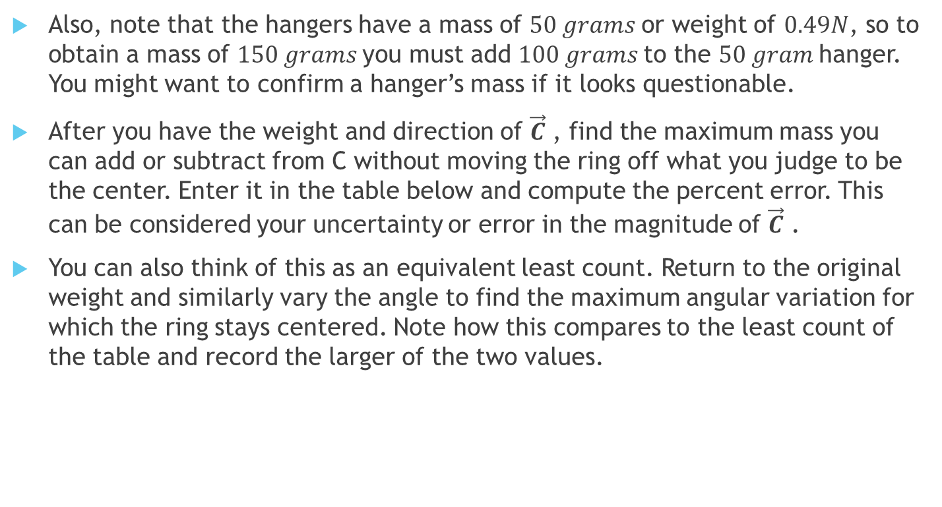
Procedure 1: Balancing Forces, Cont.
Also, note that the hangers have a mass of $50 grams$or weight of $0.49N$, so to obtain a mass of $150 grams$you must add $100 grams$to the $50 gram$hanger. You might want to confirm a hanger’s mass if it looks questionable.
After you have the weight and direction of $\vec{C}$ , find the maximum mass you can add or subtract from C without moving the ring off what you judge to be the center. Enter it in the table below and compute the percent error. This can be considered your uncertainty or error in the magnitude of $\vec{C}$ .
You can also think of this as an equivalent least count. Return to the original weight and similarly vary the angle to find the maximum angular variation for which the ring stays centered. Note how this compares to the least count of the table and record the larger of the two values.
 | MAGNITUDE | DIRECTION
C_{EXP} | _______ ± ____ N( ____ %) | ______ ± ____ degrees

Slide 11
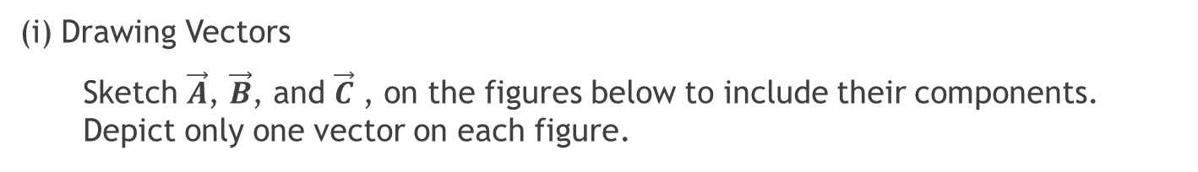
Analyzing the Experimental Data 1.
(i) Drawing Vectors
Sketch $\vec{A}$, $\vec{B}$, and $\vec{C}$ , on the figures below to include their components. Depict only one vector on each figure.

Slide 12
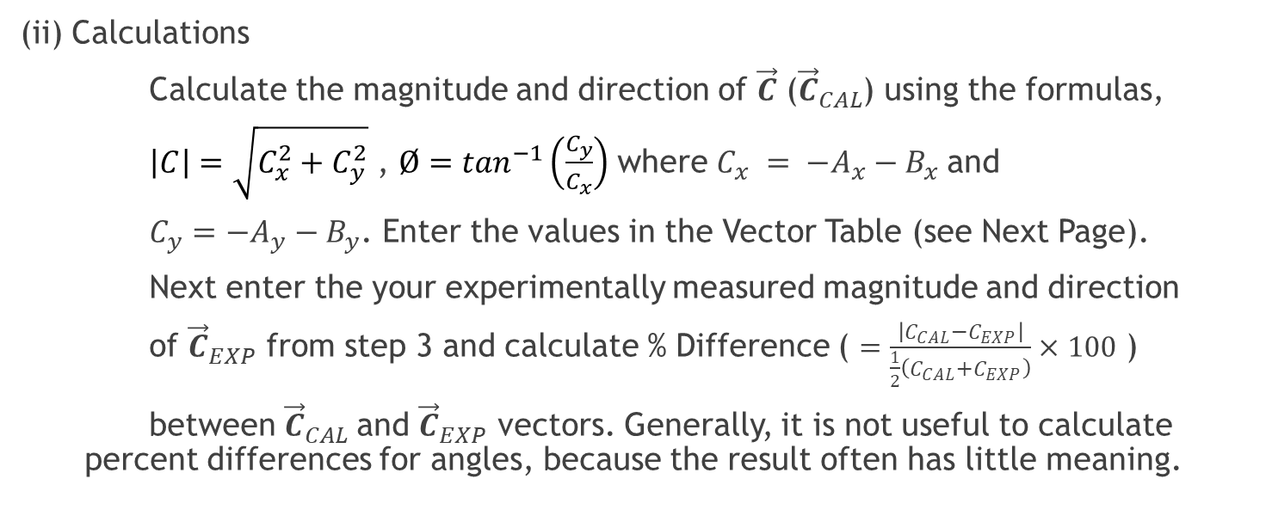
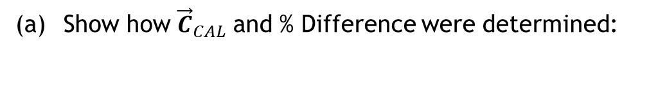
Analyzing the Experimental Data, Cont
(ii) Calculations
Calculate the magnitude and direction of $\vec{C}$ (${\vec{C}}_{CAL}$) using the formulas,
$\left|C\right|=\sqrt{C_{x}^{2}+C_{y}^{2}}$ , $Ø=\tan^{−1}\left(\frac{C_{y}}{C_{x}}\right)$ where $C_{x} = −A_{x}−B_{x}$and
$C_{y}={−A}_{y}−B_{y}$. Enter the values in the Vector Table (see Next Page).
Next enter the your experimentally measured magnitude and direction
of ${\vec{C}}_{EXP}$ from step 3 and calculate % Difference ( $=\frac{\left|C_{CAL}−C_{EXP}\right|}{\frac{1}{2}\left(C_{CAL}+C_{EXP}\right)}×100$ )
between ${\vec{C}}_{CAL}$and ${\vec{C}}_{EXP}$ vectors. Generally, it is not useful to calculate percent differences for angles, because the result often has little meaning.
(a) Show how ${\vec{C}}_{CAL}$ and % Difference were determined:

Slide 13
Vector Data Table
FORCE | MAGNITUDE ( ) | DIRECTION ( ) | x-component ( ) | y-component ( )
A
B
C _{CAL}
C _{EXP}
Difference
% Difference

Slide 14
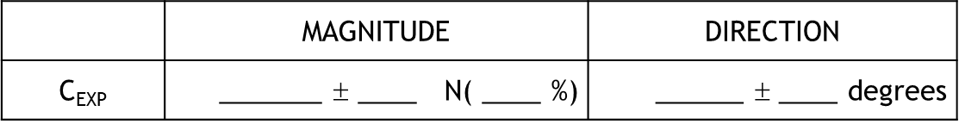
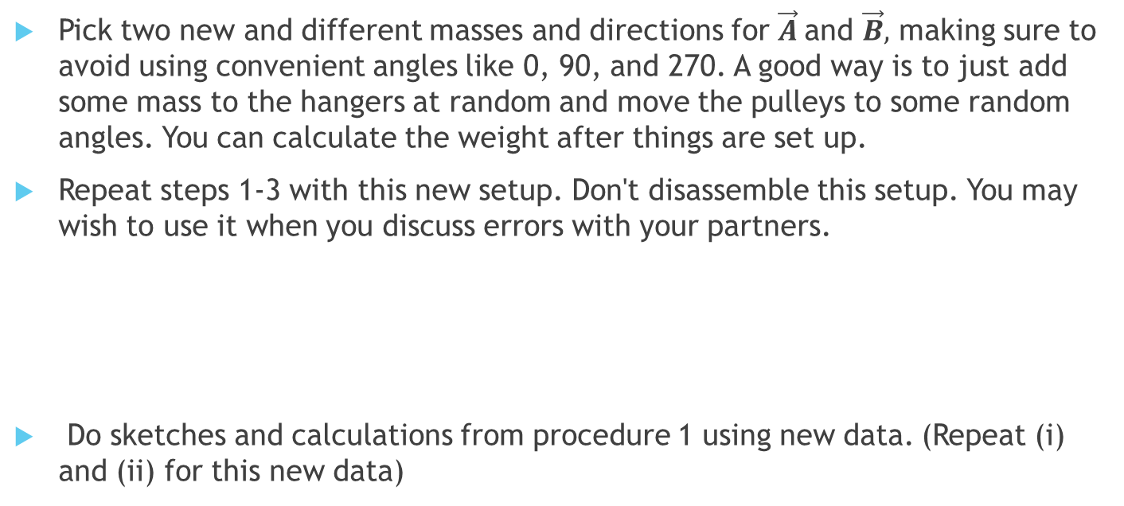
Procedure 2: Balancing Different Forces
Pick two new and different masses and directions for $\vec{A}$and $\vec{B},$ making sure to avoid using convenient angles like 0, 90, and 270. A good way is to just add some mass to the hangers at random and move the pulleys to some random angles. You can calculate the weight after things are set up.
Repeat steps 1-3 with this new setup. Don't disassemble this setup. You may wish to use it when you discuss errors with your partners.
Do sketches and calculations from procedure 1 using new data. (Repeat (i) and (ii) for this new data)

Slide 15
Procedure 2: Balancing Different Forces, Cont
FORCE | MAGNITUDE ( ) | DIRECTION ( ) | x-component ( ) | y-component ( )
A
B
C _{CAL}
C _{EXP}
Difference
% Difference

Slide 16
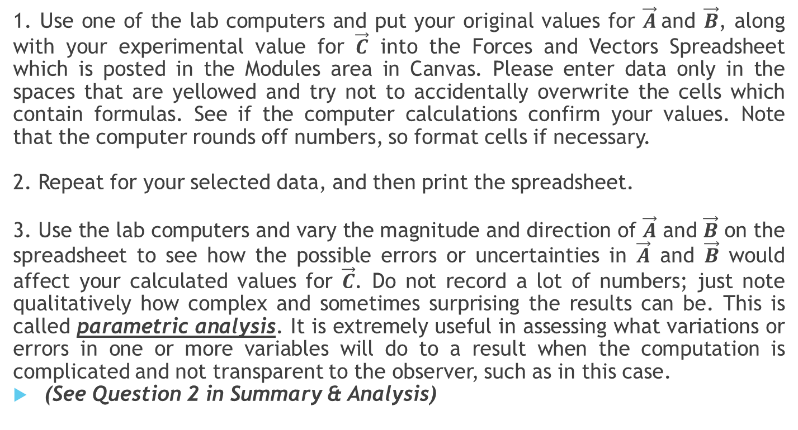
Check calculations using a Spread Sheet
1. Use one of the lab computers and put your original values for $\vec{A}$and $\vec{B}$, along with your experimental value for $\vec{C}$ into the Forces and Vectors Spreadsheet which is posted in the Modules area in Canvas. Please enter data only in the spaces that are yellowed and try not to accidentally overwrite the cells which contain formulas. See if the computer calculations confirm your values. Note that the computer rounds off numbers, so format cells if necessary.
2. Repeat for your selected data, and then print the spreadsheet.
3. Use the lab computers and vary the magnitude and direction of $\vec{A}$ and $\vec{B}$ on the spreadsheet to see how the possible errors or uncertainties in $\vec{A}$ and $\vec{B}$ would affect your calculated values for $\vec{C}$. Do not record a lot of numbers; just note qualitatively how complex and sometimes surprising the results can be. This is called parametric analysis. It is extremely useful in assessing what variations or errors in one or more variables will do to a result when the computation is complicated and not transparent to the observer, such as in this case.
(See Question 2 in Summary & Analysis)

Slide 17
Summary and Analysis Questions
1. Even if your experimental numbers exactly matched the calculated ones, there was still error.
Describe each potential error source (listed below) and classify it as random or systematic.
a. Are the pulleys a source of error? How?
b. What would an improperly leveled table do to your results?
2. Explain what you learned from the parametric analysis.
3. Check calculations using a Spread Sheet

